Slide 1
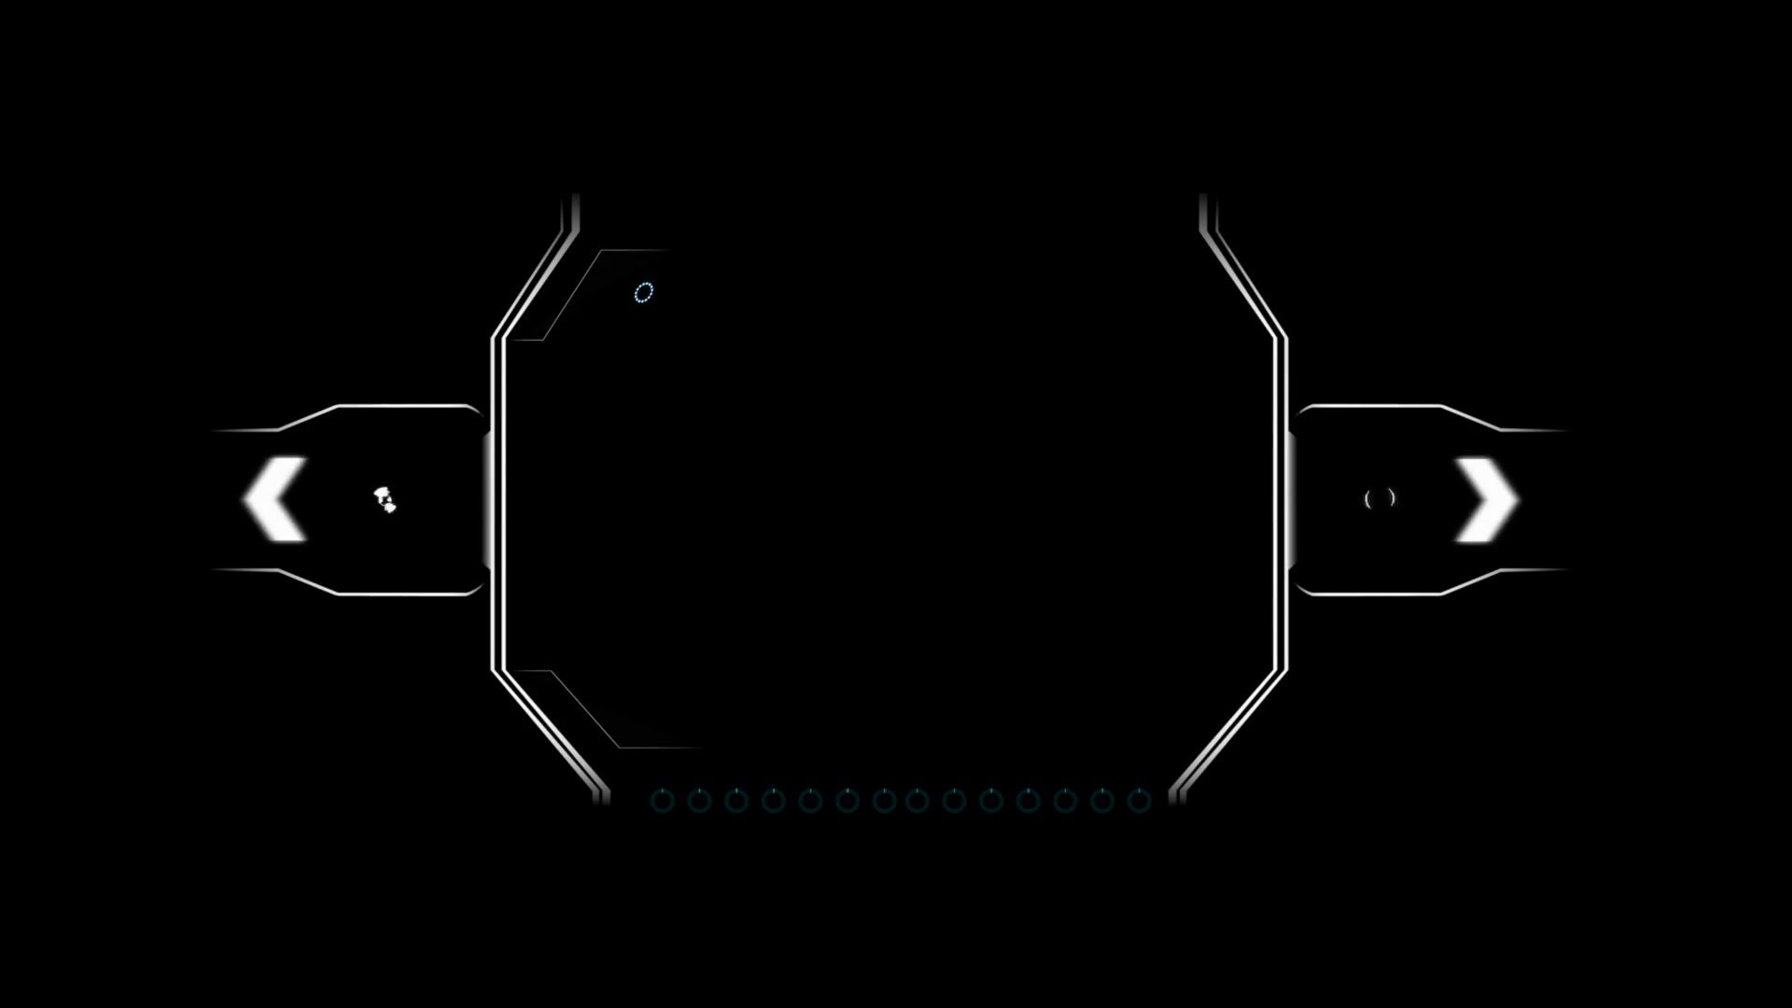
GROUP – B
ANKIT KUMAR SHAW
SUPARNO CHAKRABORTY
SUNANDA SARKAR
AKASH
SHAH

Slide 2


URBAN
CHAP TERS

Slide 3



Description
The study, which examined 70,059 original meta description examples, also discovered that:
In 15.4% of cases, Google used the original meta description tag but added some text.
In 51.3% of cases, the display snippet perfectly matched the meta description tag or fully contained it.
In 3.2% of cases, the display snippet used a truncated version of the meta description tag with an ellipsis on the end.
Stick to your brand voice and tone, but also keep it conversational.
Include your primary keyword if you can do so naturally, to tick the minimum of requirements for an SEO meta description.
Make sure you convey value to the reader.
Include a call-to-action, i.e. “Learn more here.”
Write in active voice.

Slide 4
INDEX pAGE

Slide 5
LOGIN pAGE

Slide 6
REGISTER pAGE

Slide 7
PRODUCT view

